Slide 1
Provide Insights to the Marketing Team in Food & Beverage Industry.

Slide 2
About the company
🔸CodeX is a German beverage company that is aiming to make its mark in the Indian market.
🔸A few month ago, they launched their energy drink in 10 cities of india.
🔸They conducted a survey in those 10 cities and received results from 10k respondents.
Task
🔸To convert the survey results to meaningful insights to the marketing team can use to drive actions.
🔸The target audience is the Chief Marketing Officer.
🔸Their Marketing team is responsible for increasing brand awareness, market share and product development.

Slide 3
TABLE OF CONTENTS
🔸DEMOGRAPHICH INSIGHTS
🔸CONSUMER PREFERENCES
🔸COMPETITION ANALYSIS
🔸MARKETING CHANNELS & BRAND AWARENESS
🔸BRAND PENETRATION
🔸PURCHASE BEHAVIOUR
🔸PRODUCT DEVELOPMENT
🔸INDIA ENERGY DRINK MARKET
🔸RECOMMEDATIONS

Slide 4
DEMOGRAPHIC INSIGHTS

Slide 5
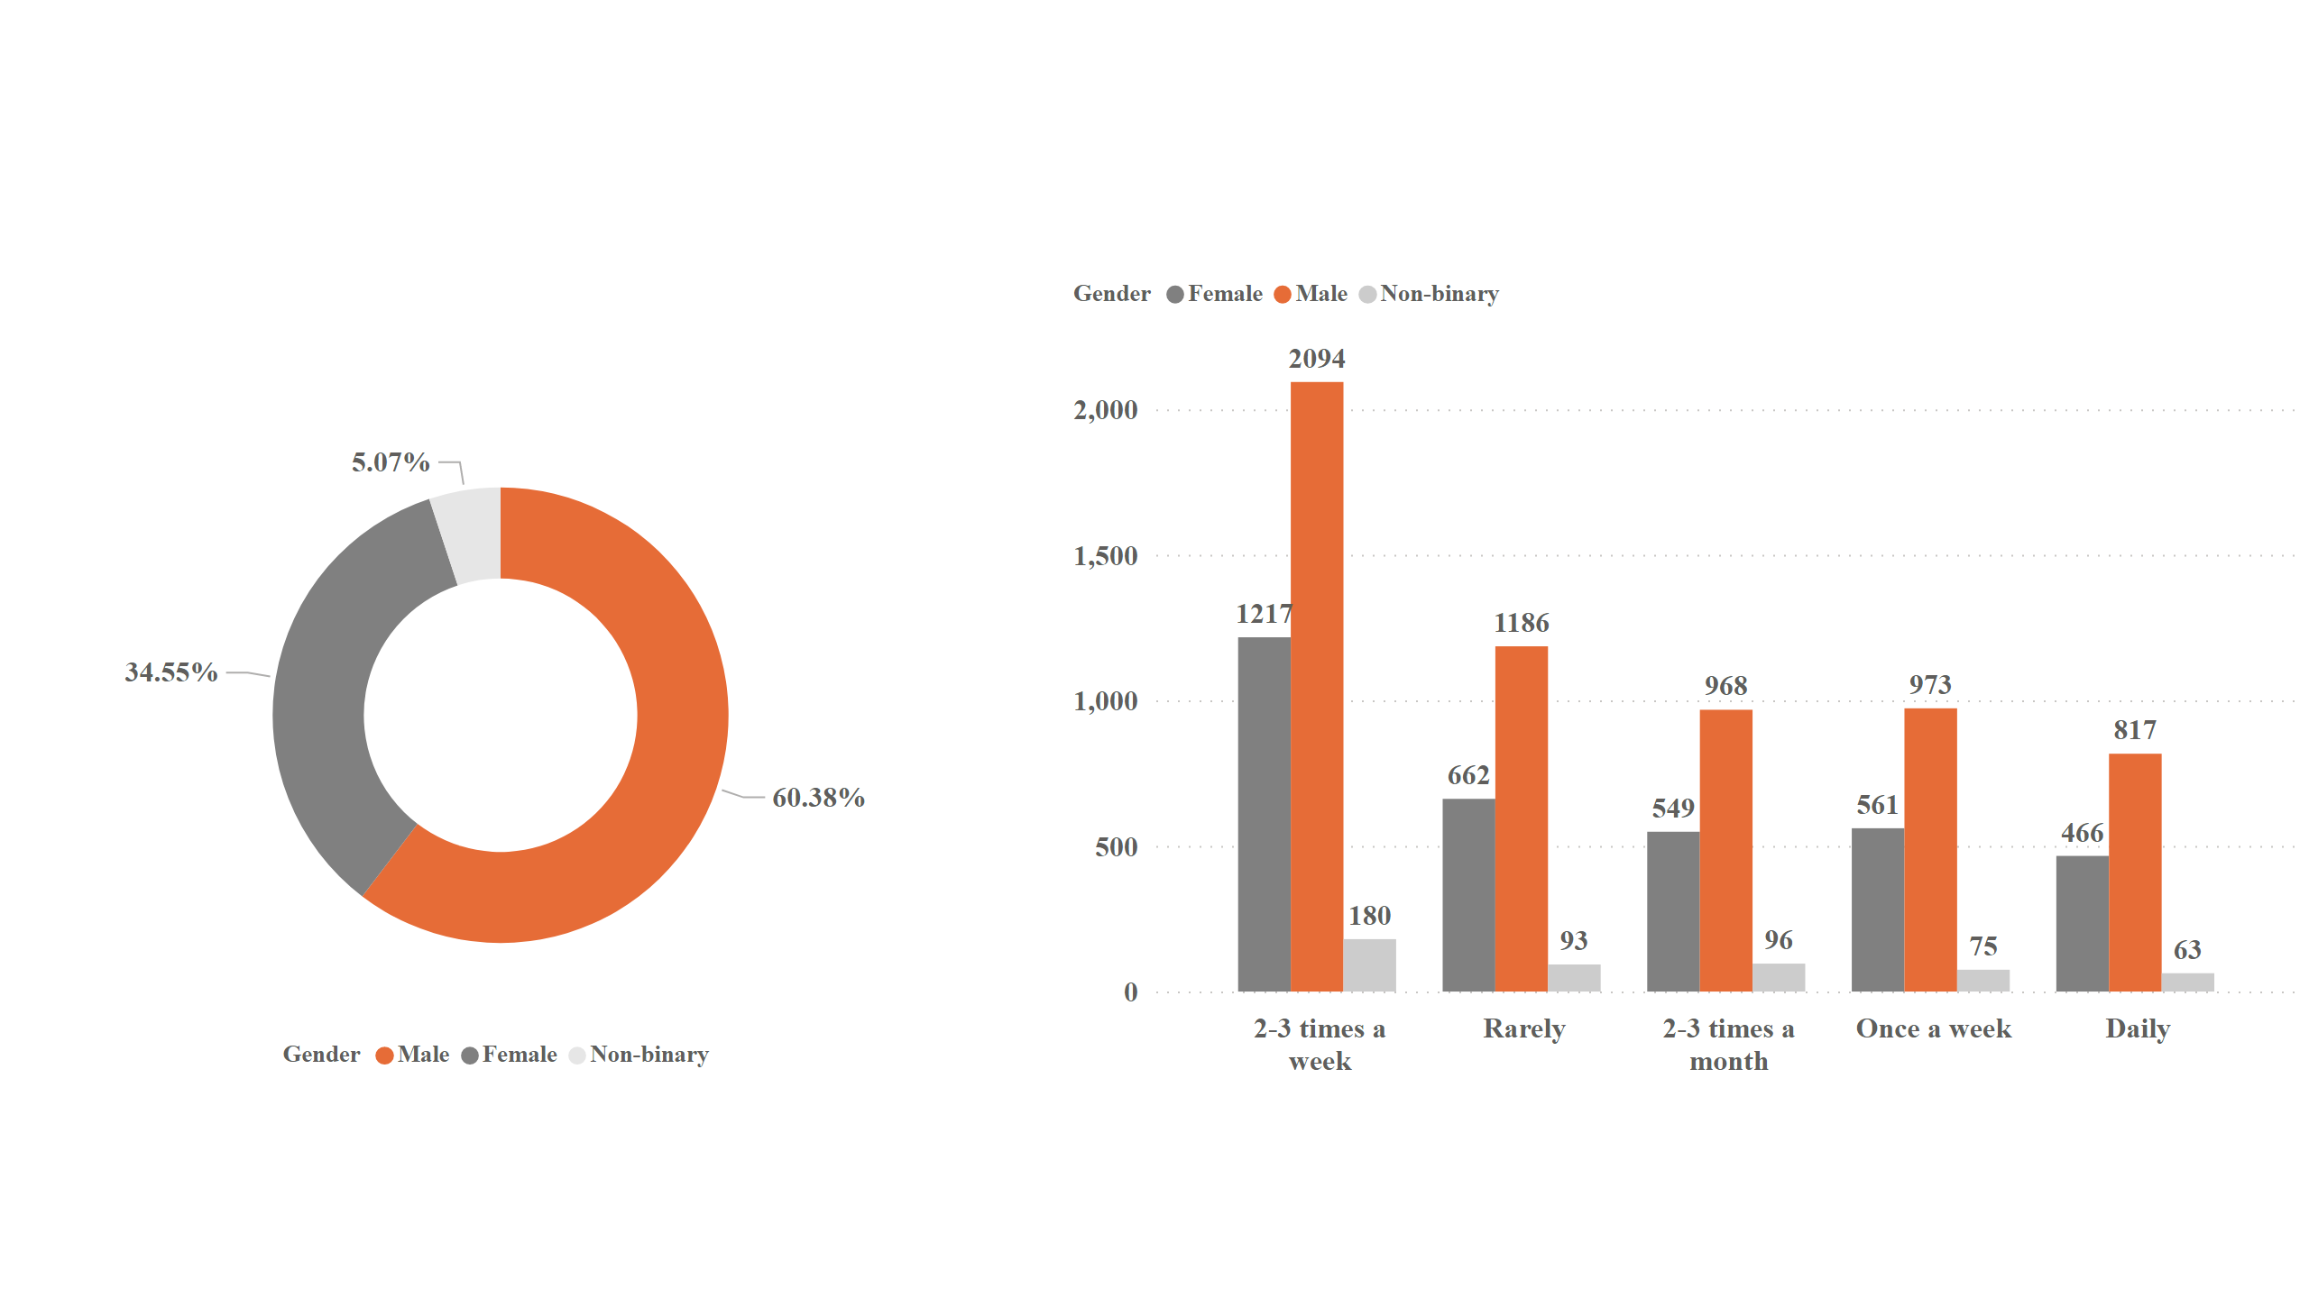
Q) 1
Q) Who prefer energy drink more ? (male/female/non-binary)
Energy Drink Preferences – Men Lead the charge
Notes:
donutChart
No alt text provided
clusteredColumnChart
No alt text provided

Slide 6
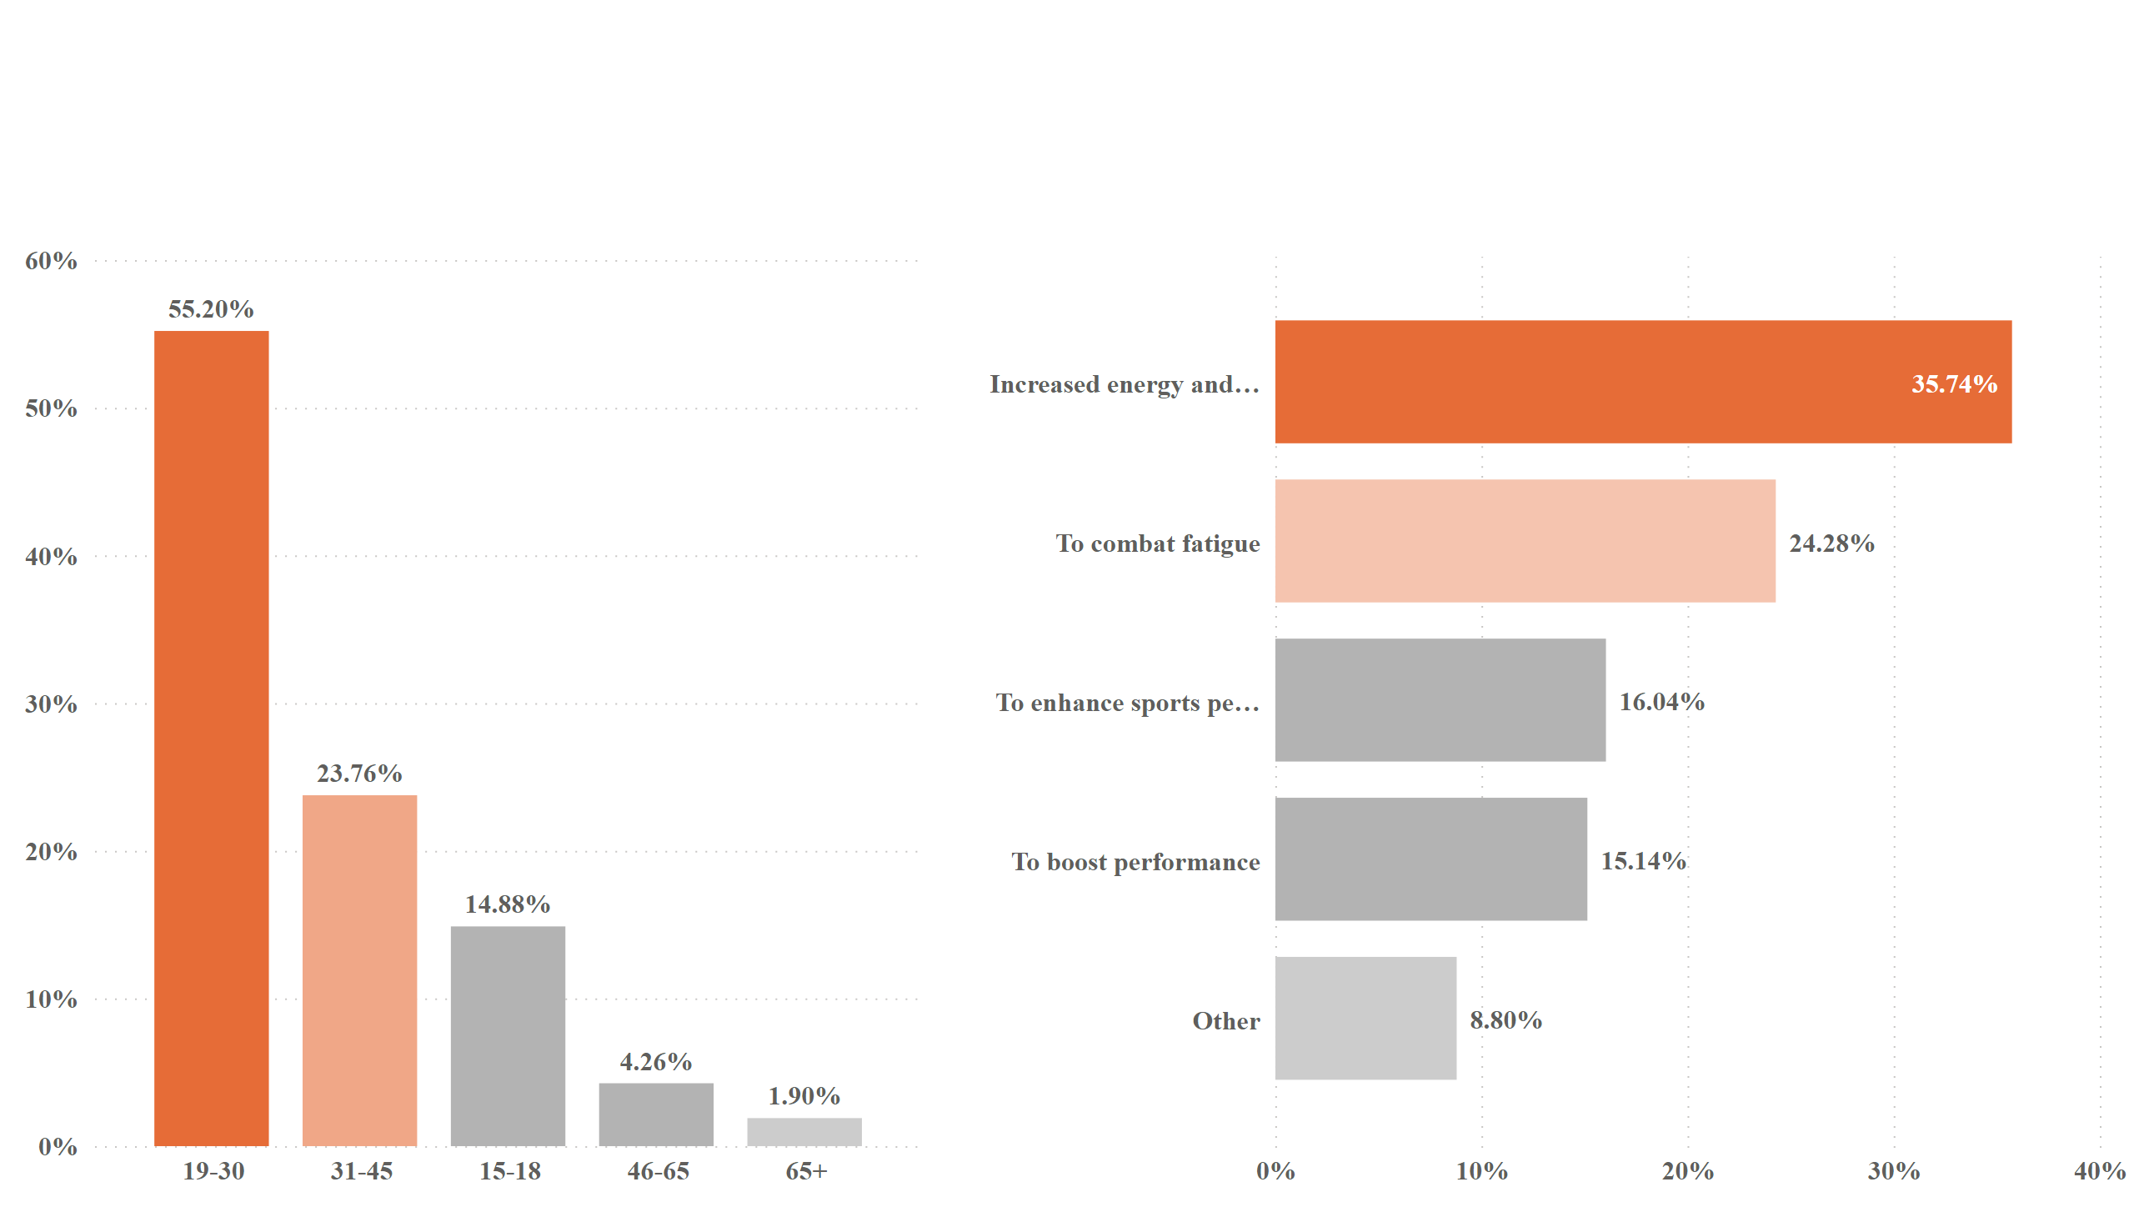
Q) 2
Q) Which age group prefers energy drinks more ?
19-30 Years olds prefer energy drinks to Increased energy and focus
Notes:
columnChart
No alt text provided
barChart
No alt text provided

Slide 7
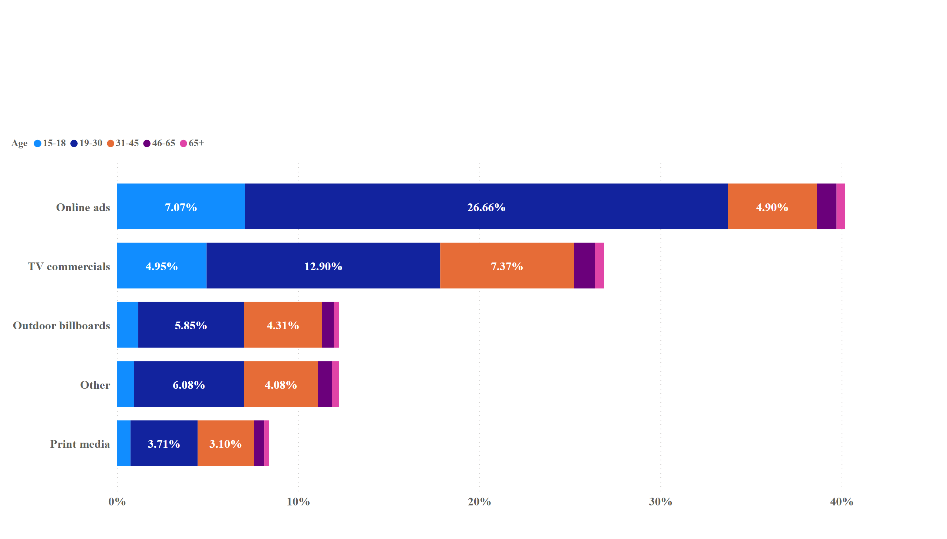
Q) 3
Q) Which type of marketing reaches the most youth (15-30) ?
Online Ads are preferred marketing channels for energy drinks Advertisements among 15-30 Years old Respondents
Notes:
barChart
No alt text provided

Slide 8
CONSUMER PREFFERENCES

Slide 9
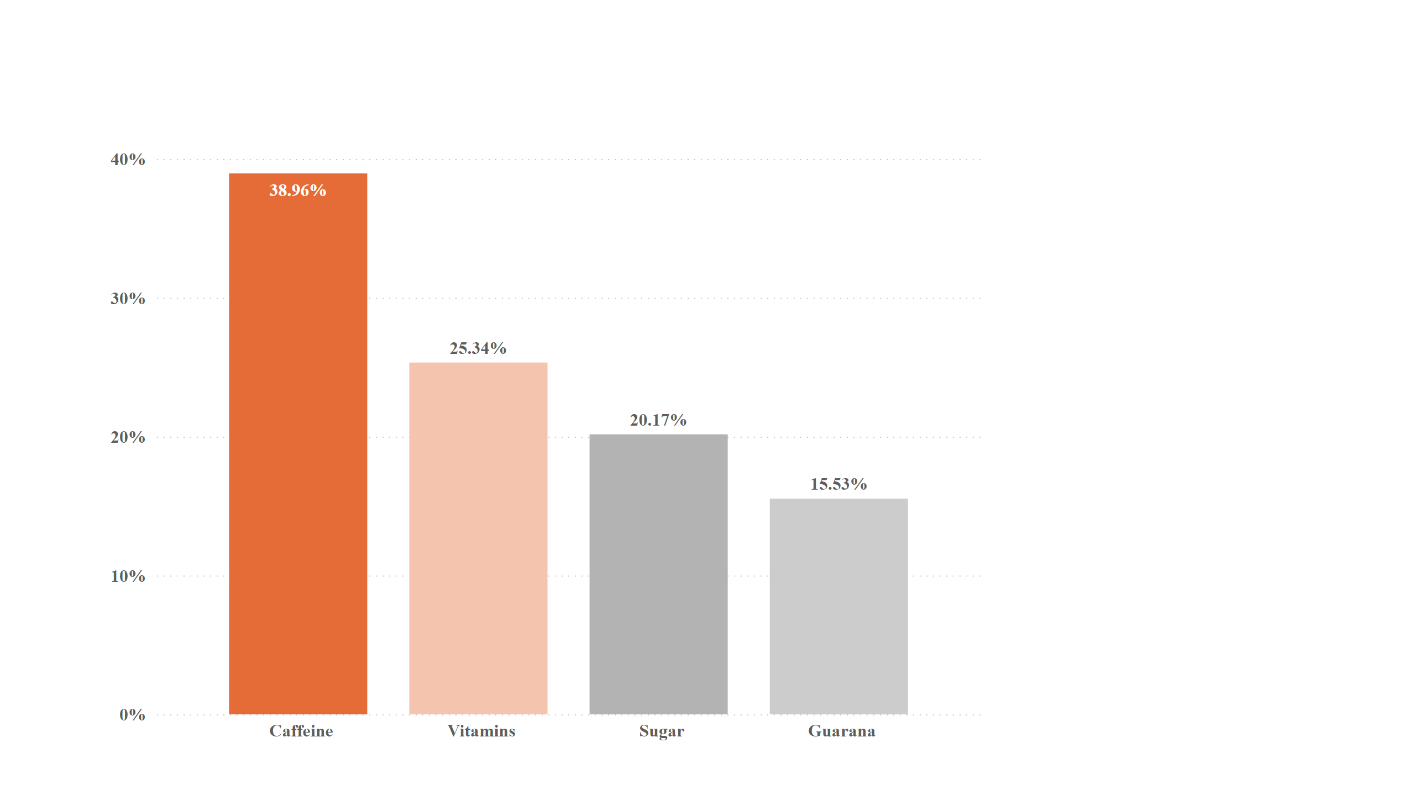
Consumer Preference Q) 4
Q) What are the preferred ingredients of energy drinks among respondents ?
Top Ingredients of choice – Caffeine & Vitamins is preferred energy drinks
*Caffeine is a stimulant that can help people stay awake and feel more alert.
*Vitamins play important roles in the body’s energy metabolism.
Notes:
columnChart
No alt text provided

Slide 10
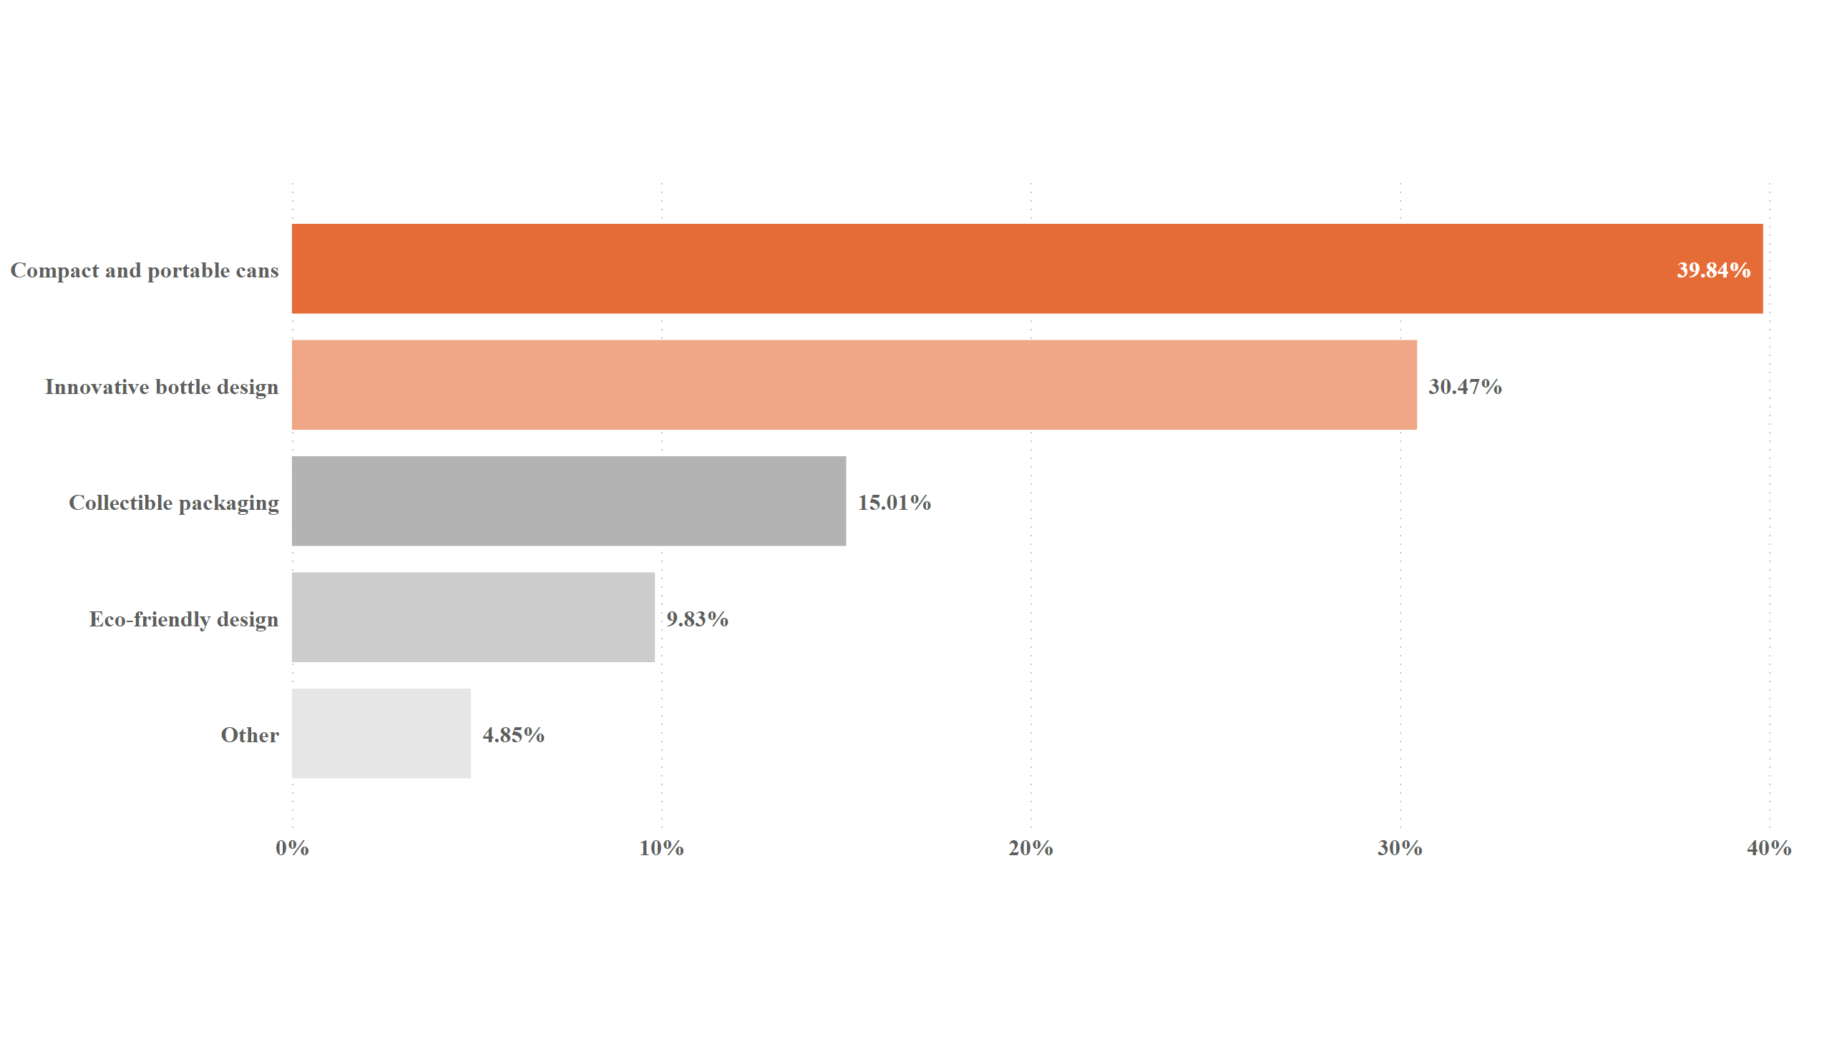
Consumer Preference Q) 5
Q) What packaging preferences do respondents have for energy drinks ?
Preferred packaging formats for energy drinks :- Compact & Portable cans And Innovation bottle design
Convenience:- Compact & Portable cans are easy to carry around.
Innovation Design:- Innovation design can make energy drinks more appealing to consumers.
Notes:
barChart
No alt text provided

Slide 11
COMPETITION ANALYSIS

Slide 12
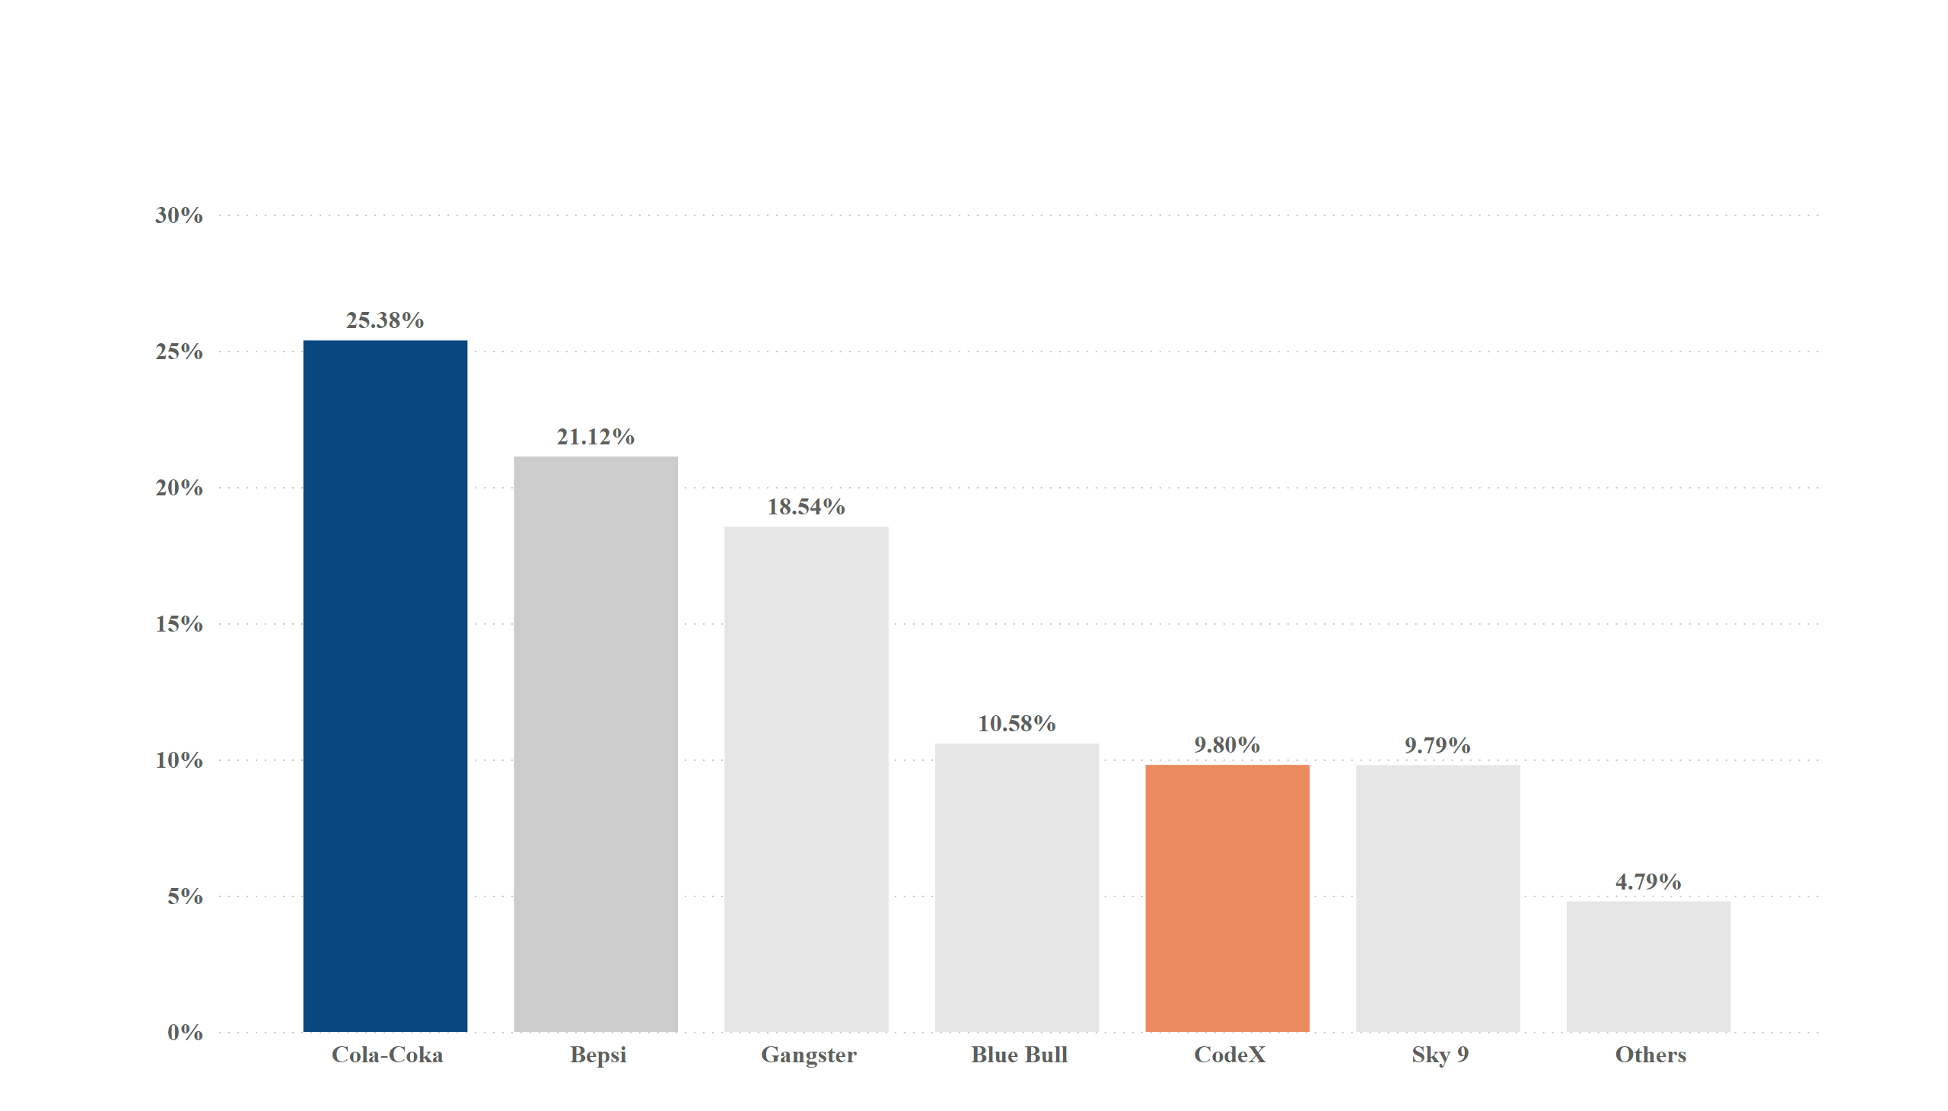
Competition Analysis Q) 5
Q) Who is current market leaders ?
Energy Drinks preferences among survey respondents
Notes:
columnChart
No alt text provided

Slide 13
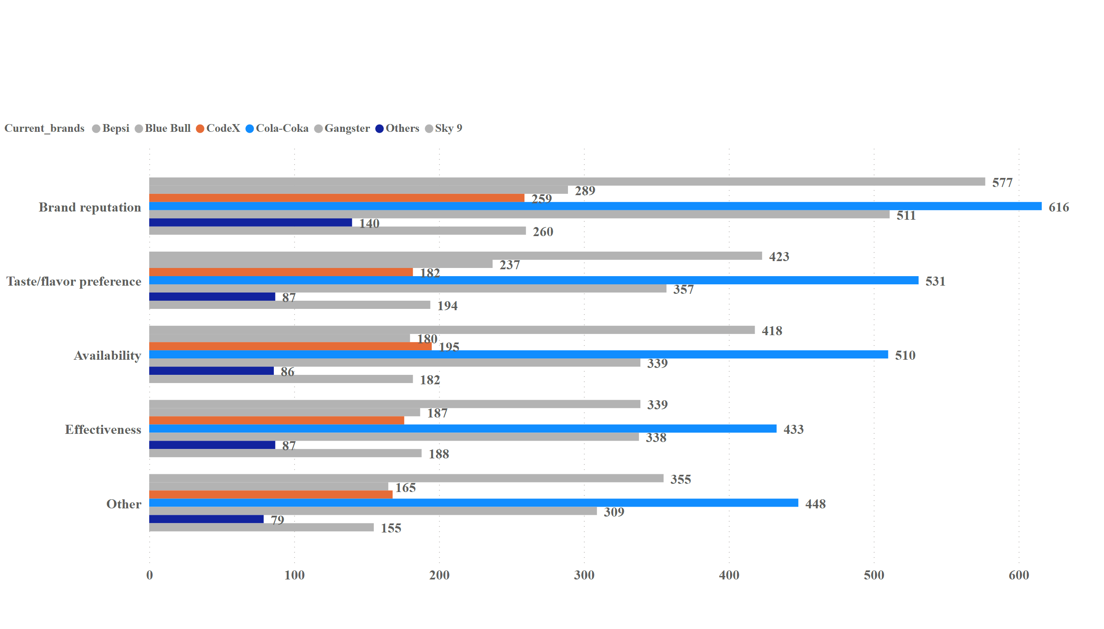
Competition Analysis Q) 6
Q) What are the primary reason consumers prefer those brands over ours ?
Consumers preferences :- Key factors driving brands loyalty – Cola-Coka vs CodeX
Notes:
clusteredBarChart
No alt text provided

Slide 14
MARKETING CHANNELS & BRAND AWARENESS

Slide 15
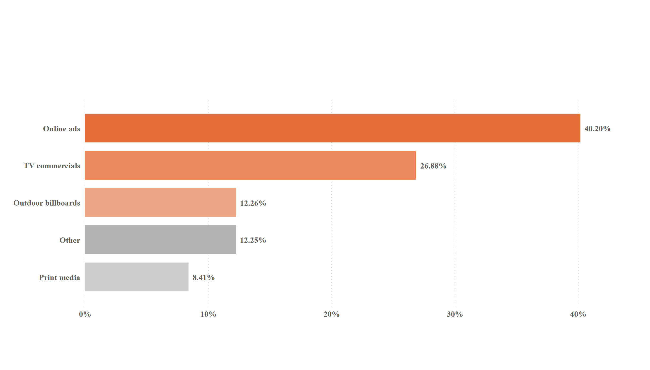
Marketing Channels & brand Awareness Q) 6
Q) Which marketing channel can be used to reach more customers ?
Preferred marketing channels :- Online Ads & TV Commercials dominate customer reach
Notes:
barChart
No alt text provided

Slide 16
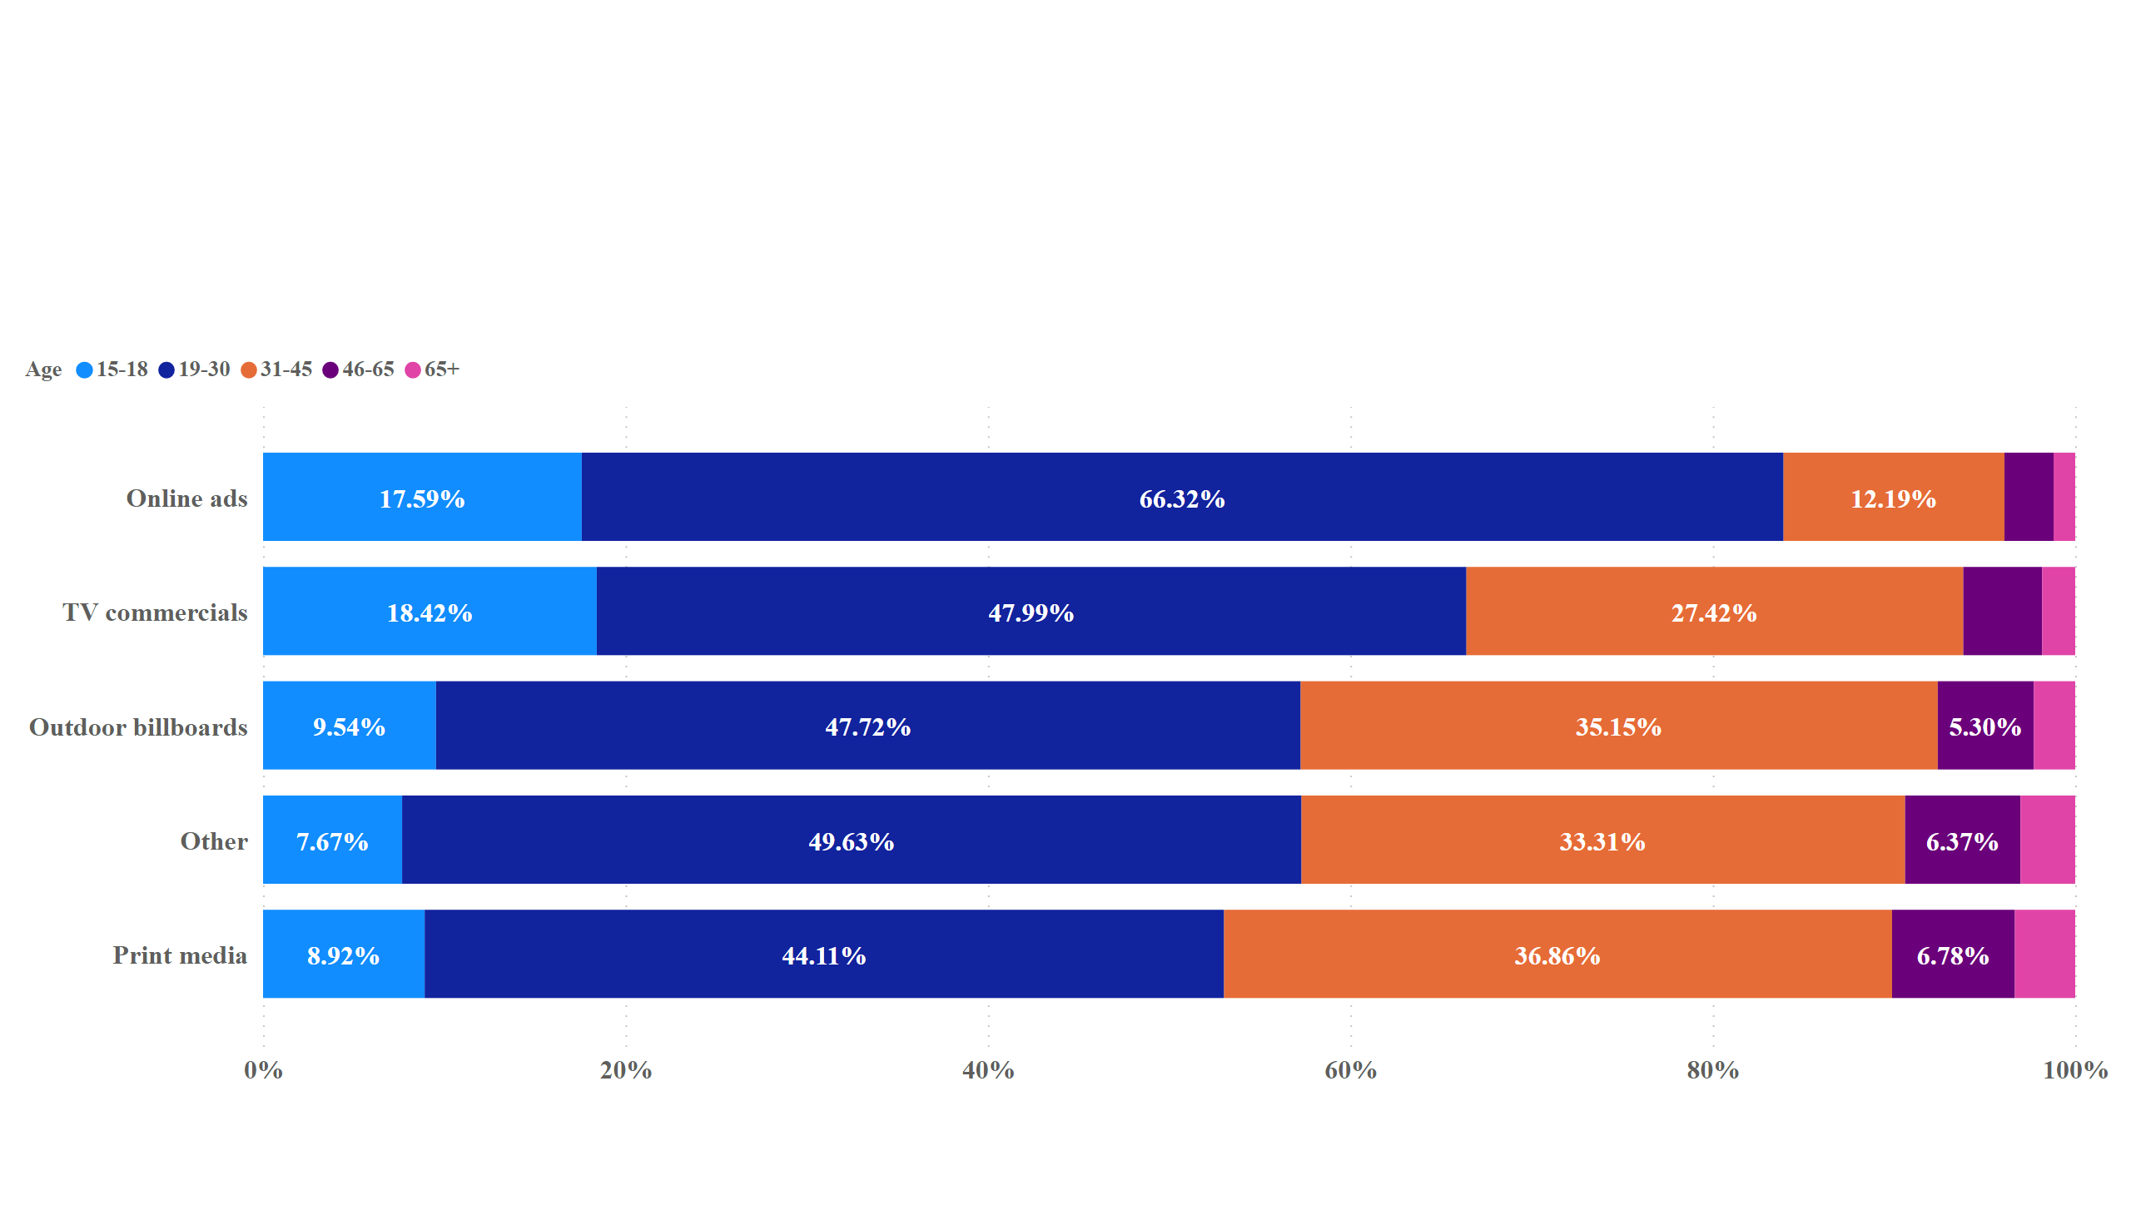
Duplicate of Marketing Channels & brand Awareness Q) 7
Q) How effective are different marketing strategies and channels in reaching our customers ?
Effectiveness of marketing strategies and channels in reaching customers across age groups
Notes:
hundredPercentStackedBarChart
No alt text provided

Slide 17
BRAND PENETRATION

Slide 18
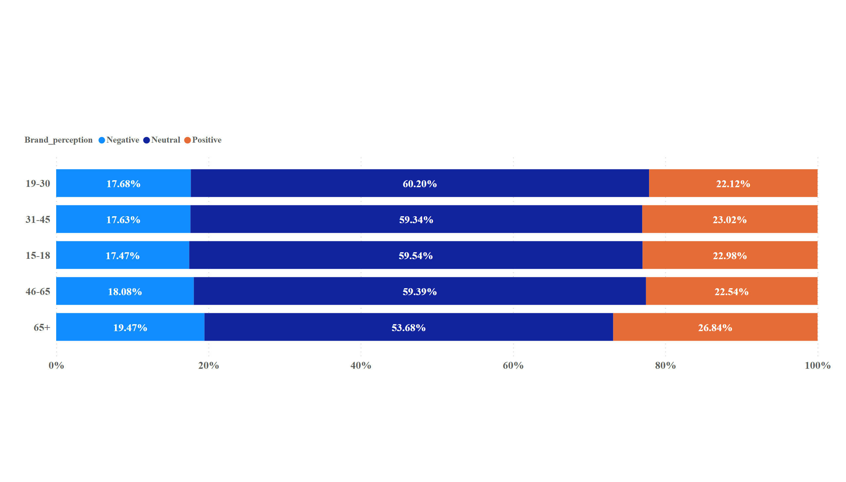
Brand Penetration Q) 8
Q) What do people think about our brands ? (Overall Ratings)
Brand Perception Across Age Groups
Overall , people have a Neutral perception of our brand
Notes:
hundredPercentStackedBarChart
No alt text provided

Slide 19
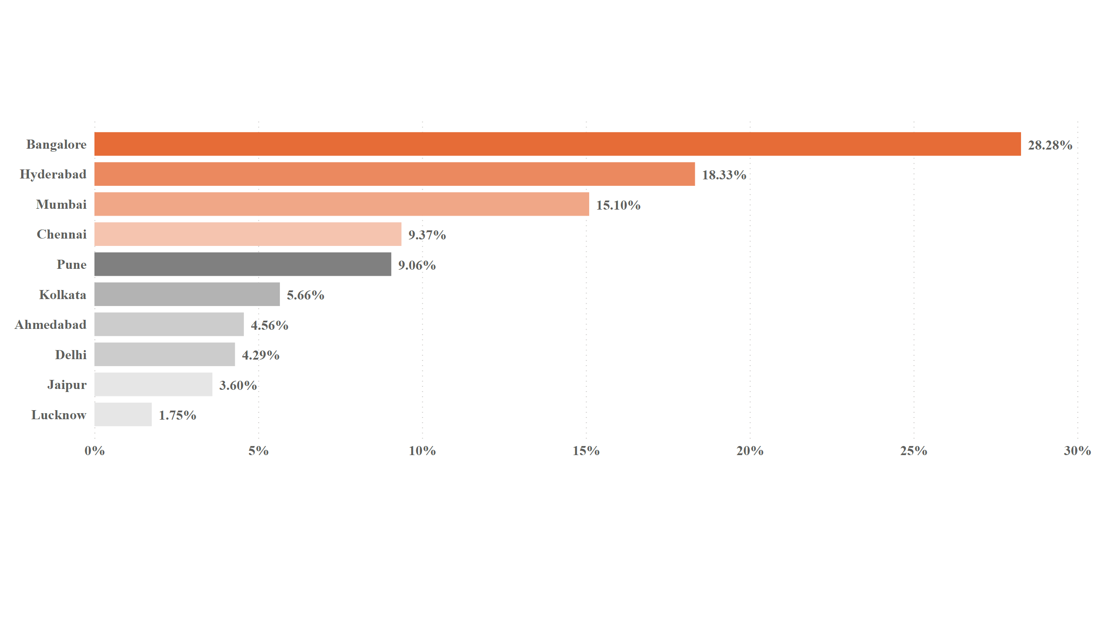
Duplicate of Brand Penetration Q) 9
Q) Which cities do we need to focus more ?
We Should focus our marketing efforts on these 4 cities because most of the youth customers from these cities.
* Grub Fest is one of the most popular food festival in india . It is organized in multiple cities across india , including - Bangalore ,Mumbai .
Notes:
barChart
No alt text provided

Slide 20
PURCHASE BEHAVIOUR

Slide 21
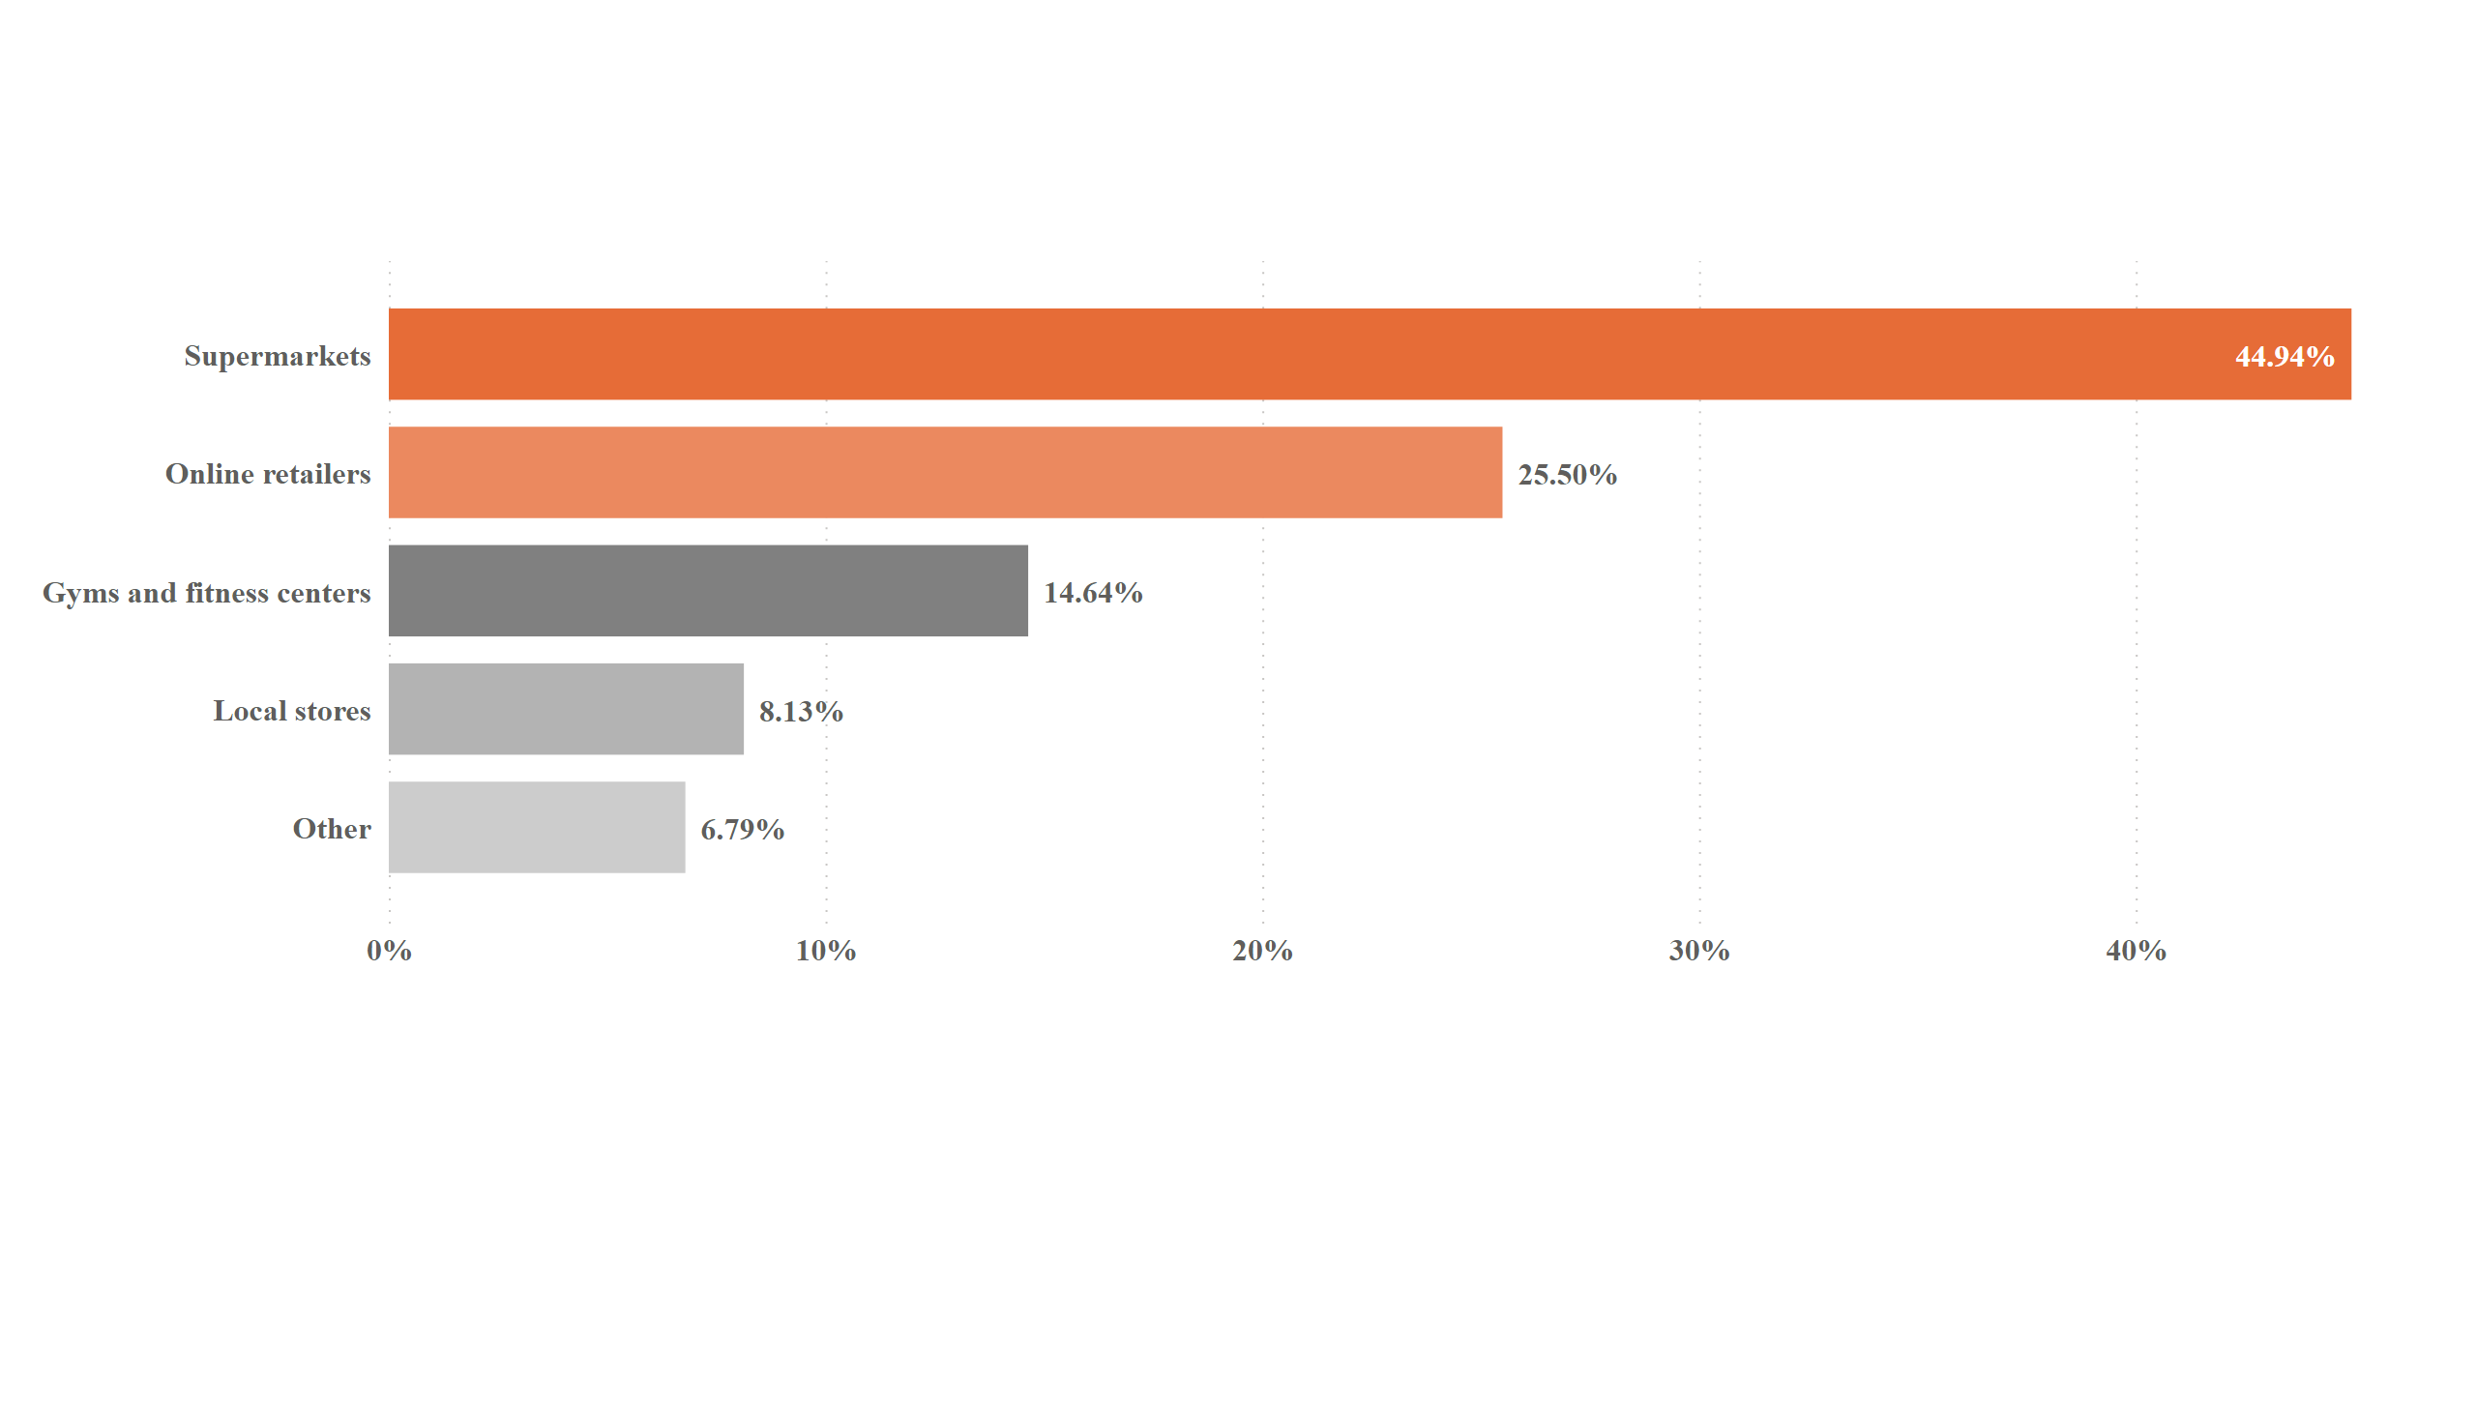
purchase behaviour Q) 10
Q) Where do respondents prefer to purchase energy drinks ?
Preferred energy drinks purchase channels :- Supermarkets & Online Retailers
This is likely because supermarkets and online retailers are convenient and offer wide variety of energy drinks to choose from.
Notes:
barChart
No alt text provided

Slide 22
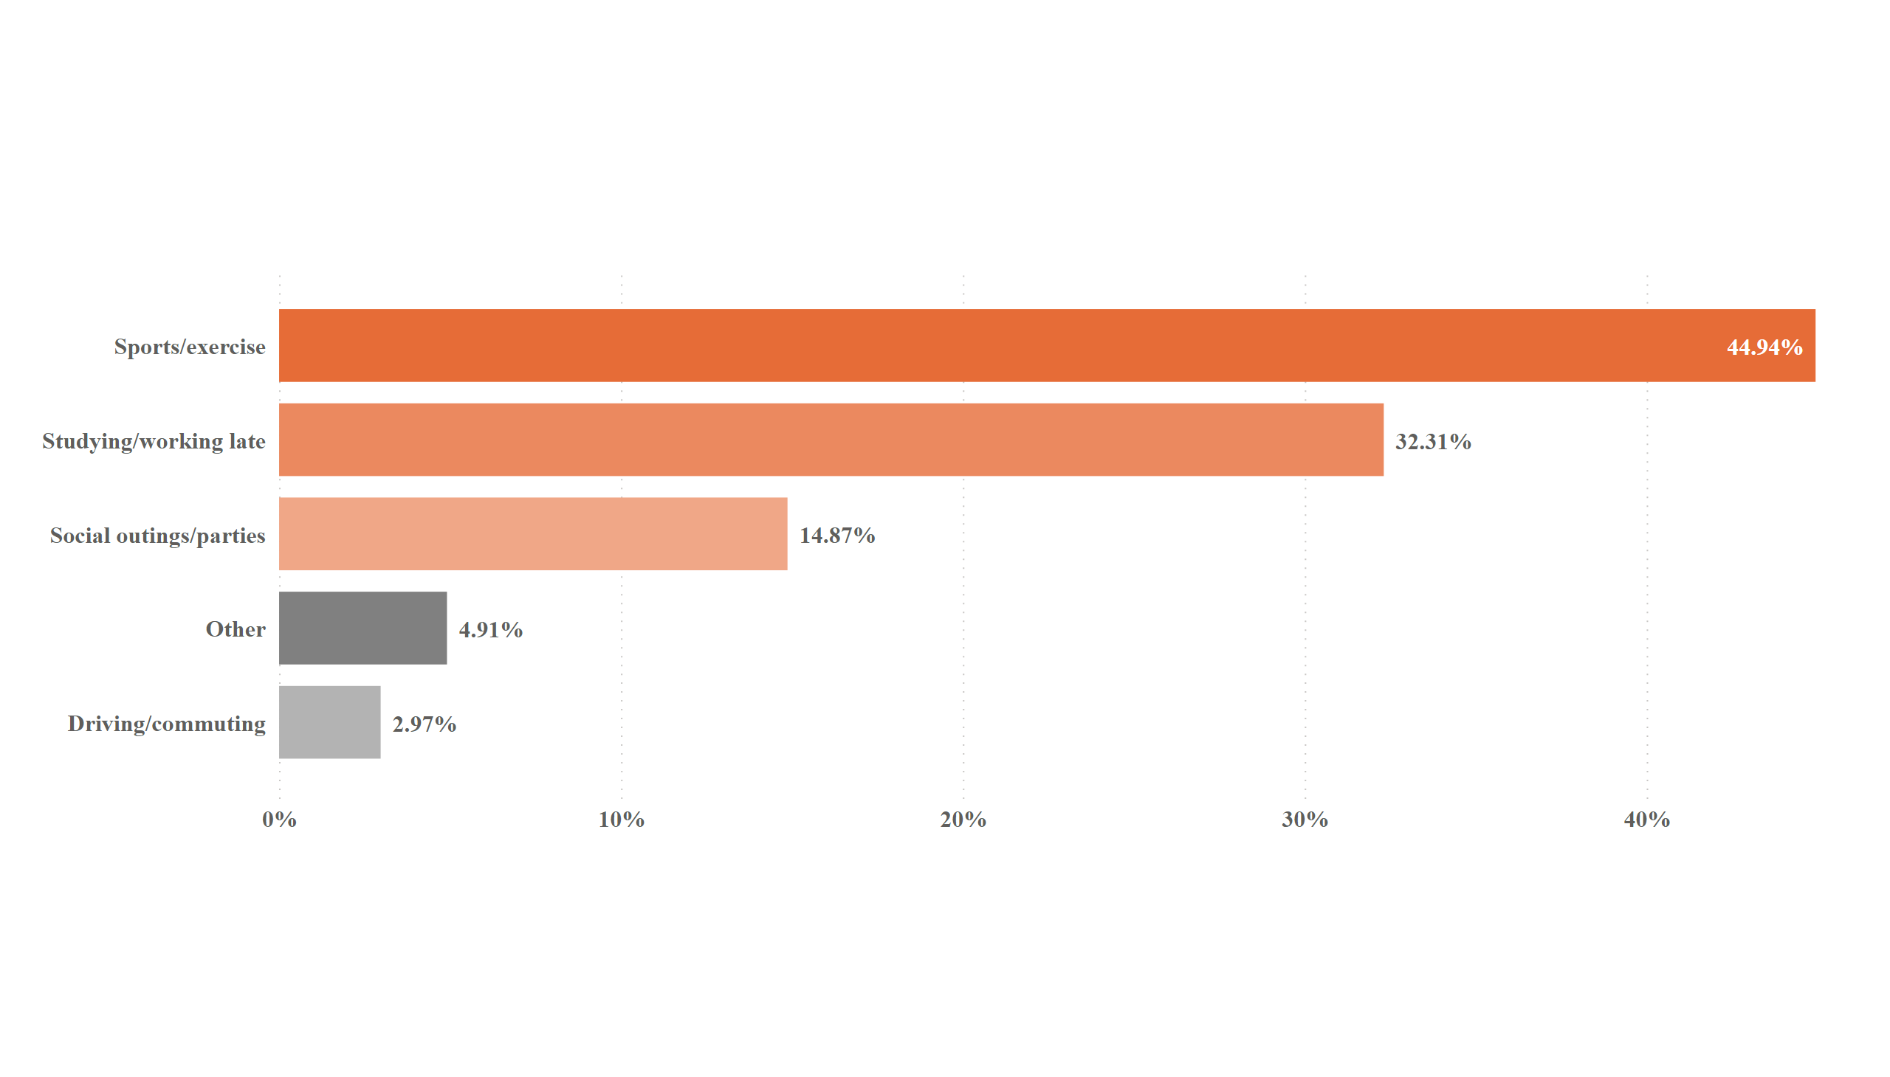
purchase behaviour Q) 11
Q) What are the typical consumption situations for energy drinks among respondents ?
Typical consumption situation for energy drinks
Notes:
barChart
No alt text provided

Slide 23
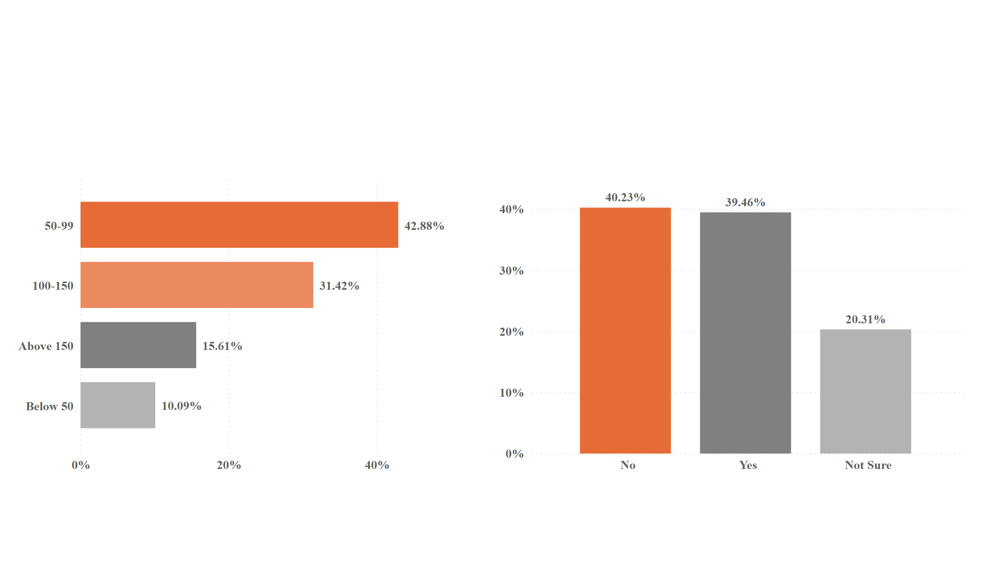
Q) 12
Q) What factors influence respondents purchase decisions , such as price range and limited edition packaging ?
Most Respondents (42.88%) consider a price range of 50-99 to be reasonable
Buying an energy drinks with Limited Edition Packaging or not
NO :- are most concerned with the taste and quality of energy drinks.
Yes :- likely to be influenced by marketing campaigns that emphasize the exclusivity of limited edition products.
This likely because this price range is affordable for most people and still offers a good value for the money.
Notes:
barChart
No alt text provided
columnChart
No alt text provided

Slide 24
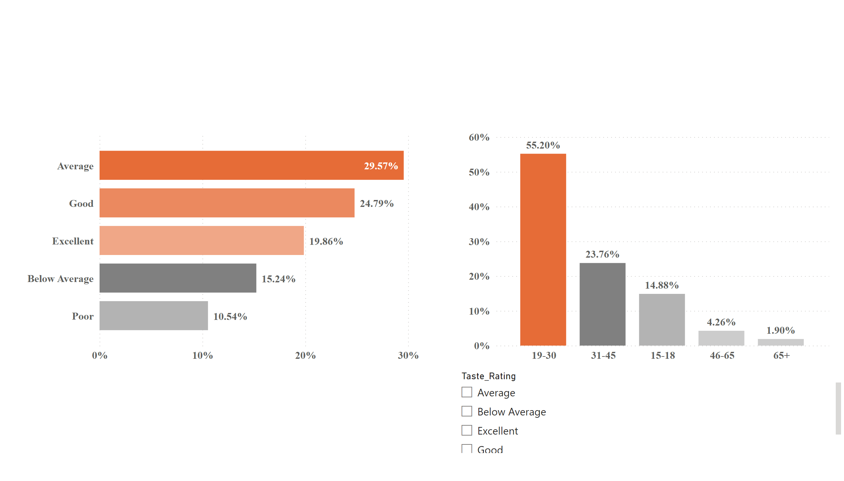
product & development Q) 13
Q) Which area of business should we focus more on our product development ? (Branding/ Taste/ Availability)
Rating of Taste, Flavour and Overall Experience
Respondents who have tried our product and given the ratings.
4881 Respondents have tried our product and below are the rating given by them.
Overall, ratings of our product are positive.
Notes:
barChart
No alt text provided
columnChart
No alt text provided
slicer
No alt text provided

Slide 25
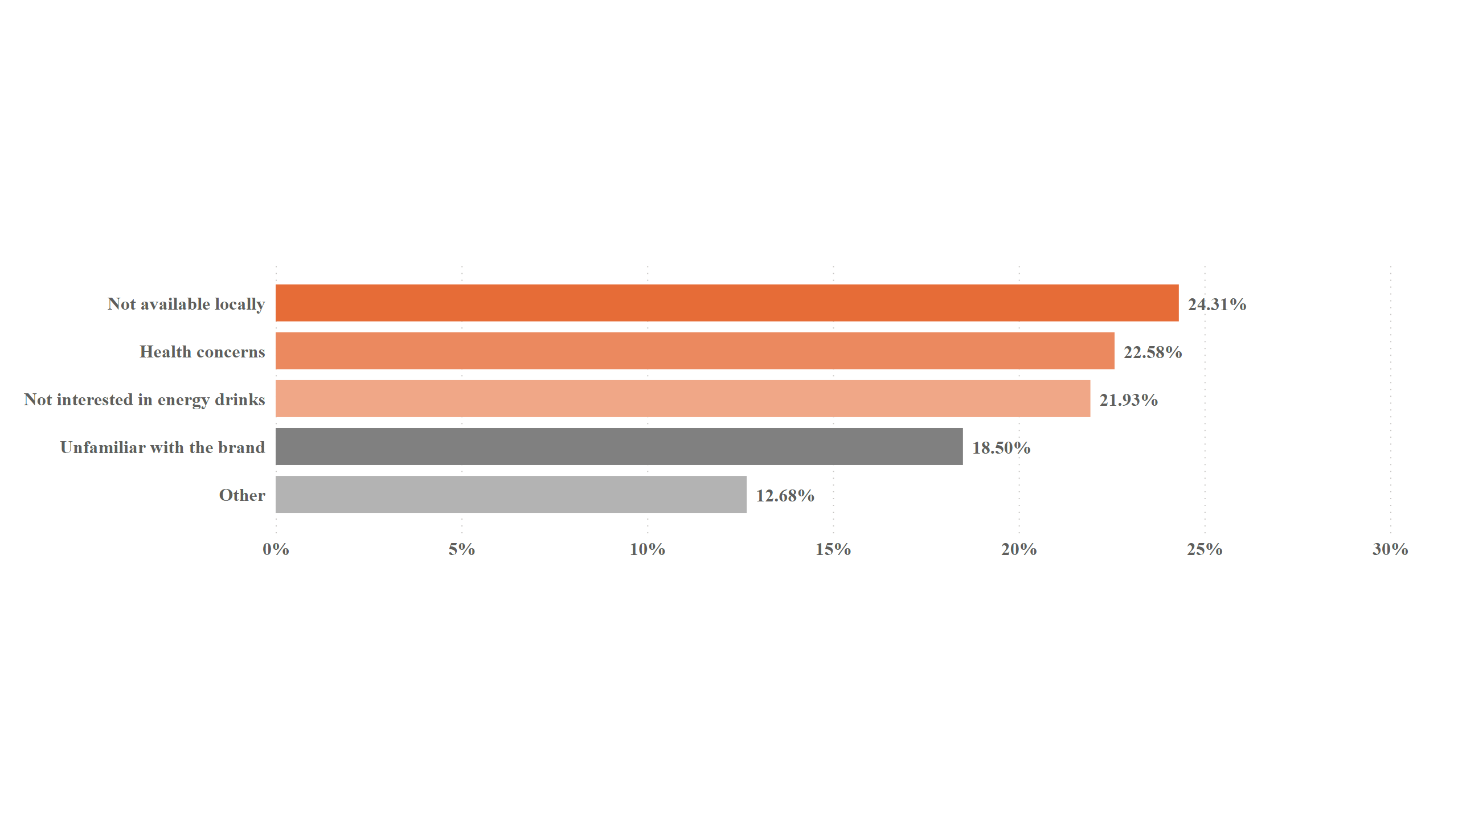
Q) 14
Respondents who never tried our product
Product is not widely available or easily accessible :- Respondents may not have had the opportunity to try it.
Consider expanding distribution channels or partnering with retailers to ensure better availability in different regions.
Notes:
barChart
No alt text provided

Slide 26
Energy Drinks Market In India
Major soft drinks companies like PepsiCO and Coca-cola enter the market for energy drinks to compete with industry leaders in india.
The Indian energy drinks market projected to register a CAGR of 9.98 over the next five years.
According to industry players, the opportunity to grow in the Indian energy drinks market is large compared with the consumption of energy drinks in the rest of the developing nations

Slide 27
RECOMMEDATIONS

Slide 28
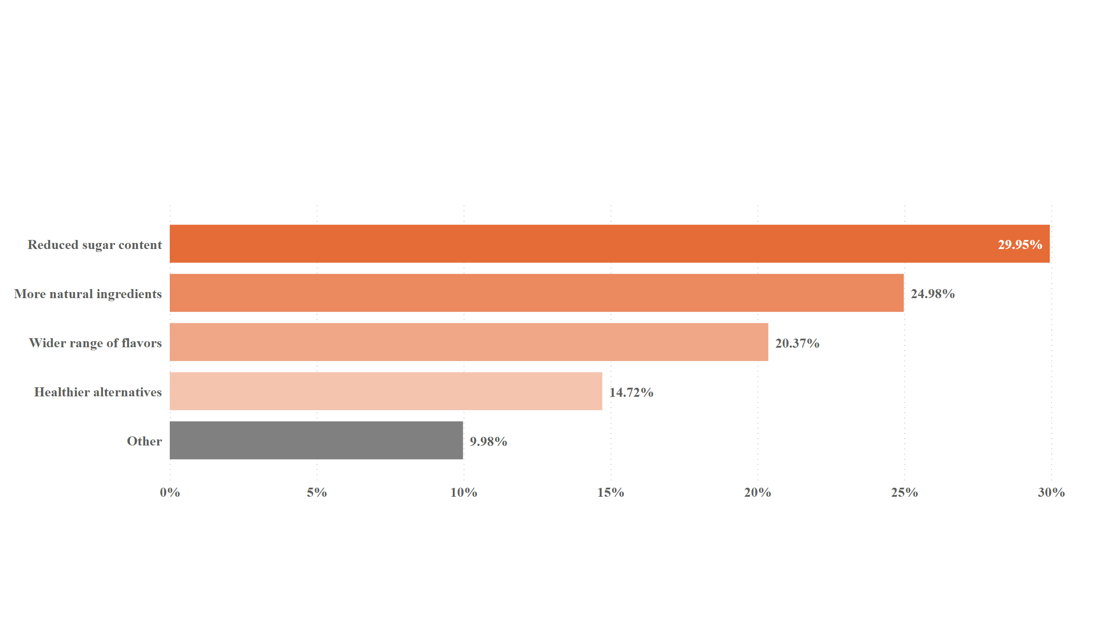
Q) 15
Q) What immediate improvements can we bring to the products ?
What improvements would you like to see in the energy drinks currently available in the market ?
➡️ Leverage Local Ingredients and Flavours to create energy drinks that are tailored to the Indian taste :-
✅ Use variety of fruits and vegetables.
✅ Incorporate traditional Indian spices.
✅ Make sure the drinks are refreshing and hydrating.
Health Impact Concerns :- Approximately 60% of respondents expressed worries regarding energy drinks.
Notes:
barChart
No alt text provided

Slide 29
Q) What measure can we implement to alleviate customer concerns and enhance their confidence in purchasing our product ?
The region where ingredients are sourced.
The testing that is done in the lab.
The number of scientists who are working to ensure the health of the energy drinks.
The reasons why the ingredients are selected.
Q) What should be the ideal price of our product ?
The ideal price of an energy drinks should be between Rs 50-99.
The Rs 50-99 is likely to be seen as a good value for money by most Indian consumers.

Slide 30
Q) What kind of marketing campaigns, offers and discounts we can run ?
Buy one get one free :- great way to introduce a new energy drink to the market.
Referral program :- Encourage customers to refer friends and family by offering rewards or discounts for successful referrals.
Events Sponsorship :-Sponsor fitness events and sports competitions.
Distribute free samples at gyms , Sporting events :- Is a great way to introduced your product to new customers and to get them to try it for the first time. It is also a great way to generate excitement and buzz about our brands.
Multipack Offers :- where customers can purchase multiple cans of your energy drinks at a discount price.

Slide 31
Q) Who can be a brand ambassador and why ?
Fitness Influencers :- Collaborating with fitness influencers who have a strong presence on social media platforms, sharing workout routines, nutrition tips and lifestyle content. They can help promote your energy drinks to health-conscious individuals.
Athletes :- Partnering with professional athletes or sports personalities can be beneficials.
Celebrities :- Engaging celebrities who are known for their active lifestyle.
Some specific qualities that we need to look for in a brand ambassador :-
Should be someone who is energetic and motivated.
Should be someone that people look up and respect.
Should have long following on social media or be well known in their community.

Slide 32
Q) Who should be our target audience and why ?
Young Adults Age 18-35.
Energy drinks are often consumed by individuals seeking an energy boots to stay alert and focused during work or study sessions.
But there is trend of health-conscious consumers seeking natural and organic options extends to the energy drink market as well.
In conclusion, the target audience for energy drink in india is a diverse group. By understanding these trends, we can develop a marketing strategy that will reach our target audience and help us to grow our business.

